Slide 1
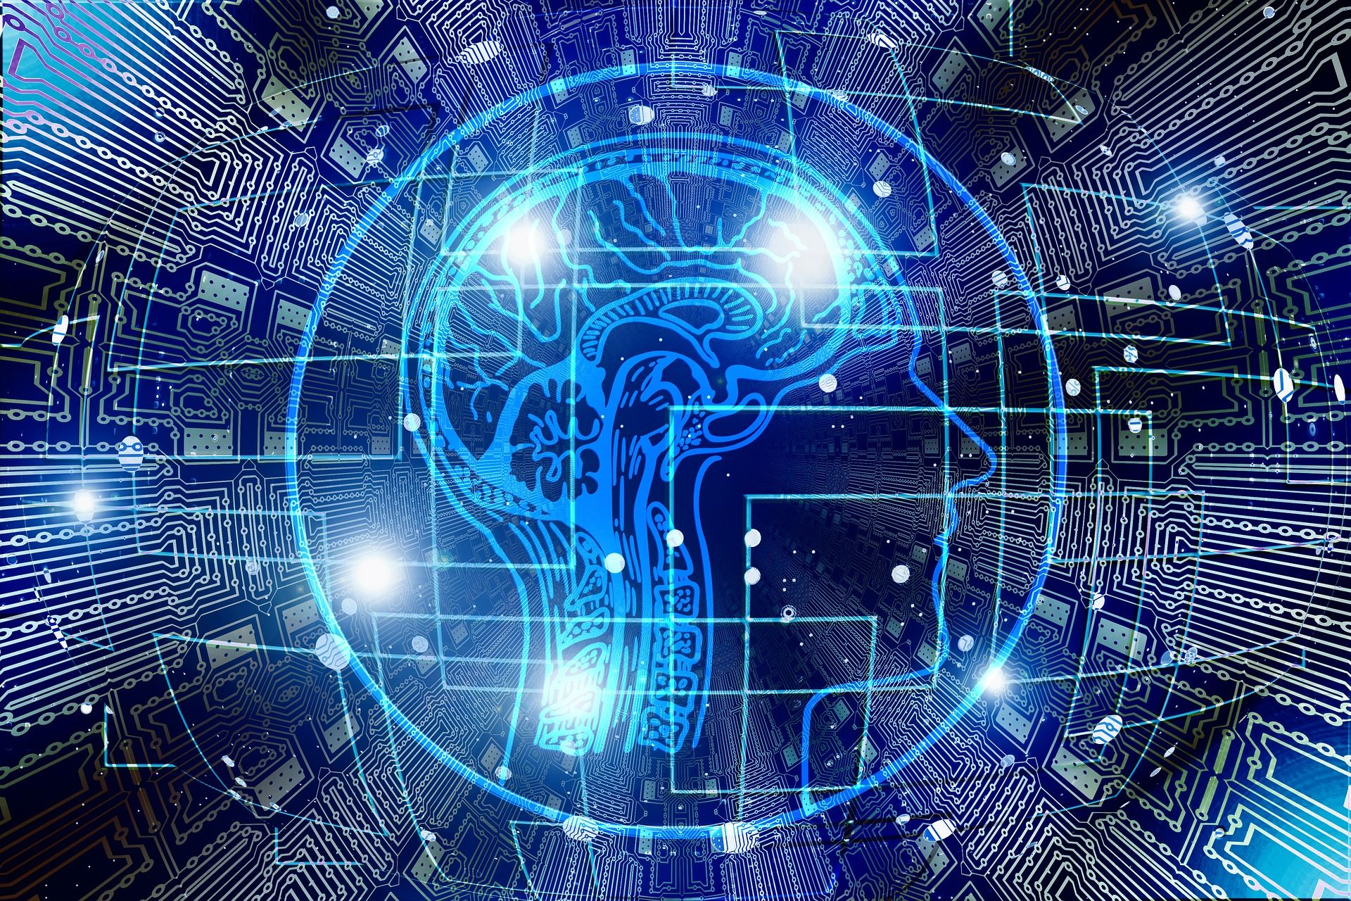

face mask detection using mobilenetv2 architecture
Presented by
J. Suresh - 171FA05026
P. Giridhar - 171FA05324
R. Karthik - 171FA05329
Guide:
Ms. A. Divya

Slide 2
OUTLINE OF THE PROJECT
Aim
Introduction
Objectives
Literature survey
Tools used
Block diagram
Activity diagram
Steps involved
Implement model
Output
Advantages and Applications
Conclusion
References

Slide 3
AIM
Our project aims at designing a system to find out whether a person is using a mask or not by real time monitoring using a camera with help of deep learning technique. This model is trained on a data set that consists of images of people with and without masks collected from various sources and used MOBILENETV2 architecture.

Slide 4
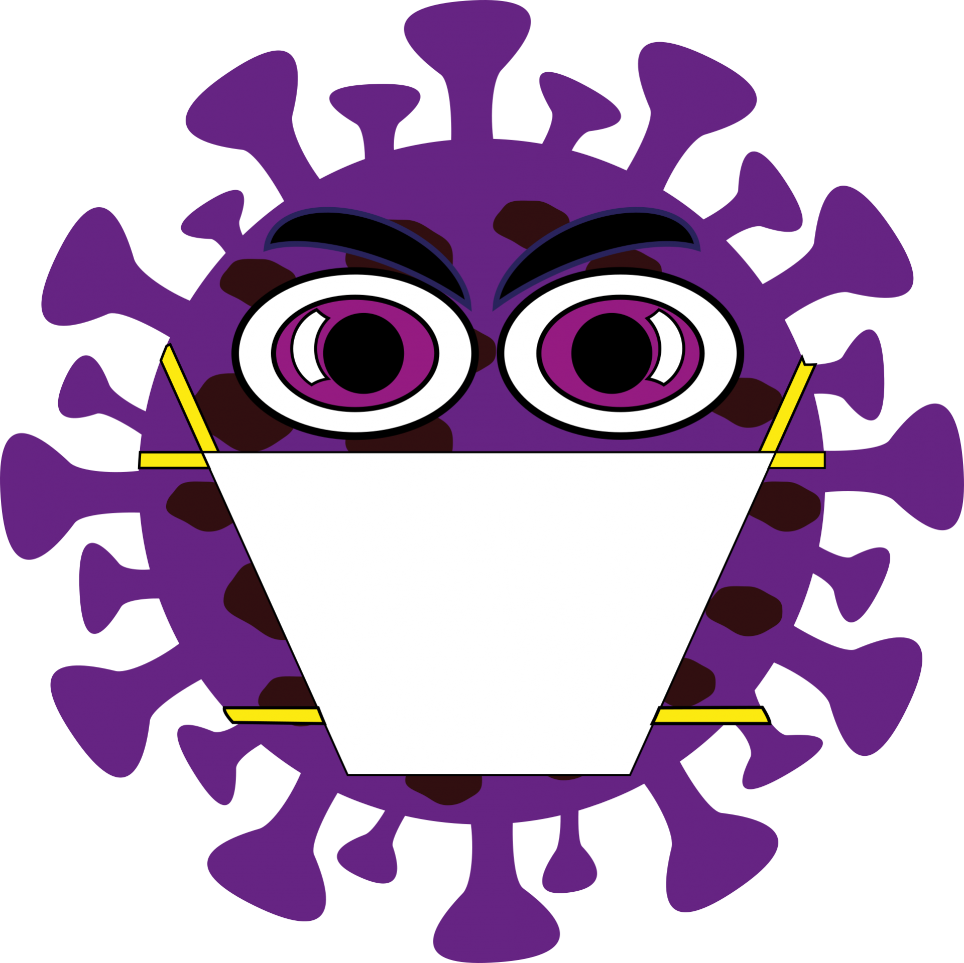
INTRODUCTION
COVID-19 pandemic caused by novel corona virus is continuously spreading until now all over the world. The impact of COVID-19 has been fallen on almost all sectors of development. Many precautionary measures have been taken to reduce the spread of this disease where wearing a mask is one of them.
Whether people are abiding by the rules and regulations to wear protective masks in crowded areas ?
No means to ensure that the safety guidelines are followed.
In this, we designed a system that restrict the growth of COVID-19 by finding out people who are not wearing any facial mask in all public places are monitored with cameras.

Slide 5
objectives
To train a custom deep learning model to detect whether a person is wearing a mask or not.
To implement the trained model to detect masks in real time videos.
The model is expected to give an accuracy of 95% and above.

Slide 6
Literature Survey
S.No | Title | Year | Author | Techniques | Advantages | Disadvantages
1 | Deep learning based on face recognition system | 2020 | Marko Arsenovic, Andras Anderla | Deep learning | It will used for face recognition | -
2 | Face Mask Detection Using MobileNetV2 in The Era of COVID-19 | 2020 | Samuel Ady Sanjaya,Suryo Adi | Haarcascade | there is no physical interaction of human with the devices for capturing the faces with cameras. | Less efficient when person is wearing black mask

Slide 7
S.No | Title | Year | Author | Techniques | Advantages | disadvantages
3 | Facemask detection with Deep learning and Computer Vision | 2020 | Vinitha,Velanitine | Deep learning and computer vision | captured from cc camera and there after applying techniques for face detection and recognition which can decrease the manual work | Less accuracy
4 | Covid-19 Face Mask Detection Using TensorFlow, Keras and OpenCV | 2020 | Mashhood Arijya Das,Rohini basak | Opencv and tensor flow | Using basic ML tools and simplified techniques the method has achieved reasonably high accuracy
5 | An Automated System to Limit COVID-19 Using Facial Mask Detection in Smart City Network | 2020 | Mohammad Marufur Rahman,Md. Milon Islam,Jong-Hoon Kim | Deep learning | It shows good accuracy even when there is less number of datasets.

Slide 8
Block Diagram

Slide 9

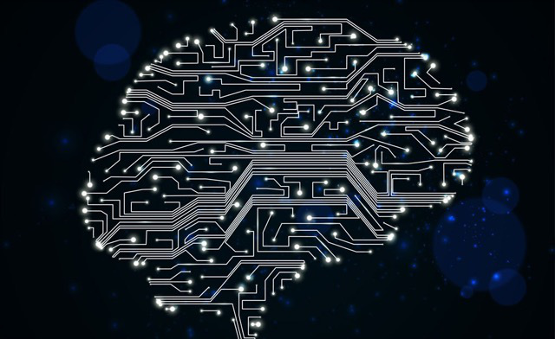
Phase 1 : Train Face mask Detector
Load face mask dataset
Train face mask classifier with Keras/Tensor flow
Serialize face mask classifier to disk
Phase 2 : Apply Face Mask Detector
Load face mask classifier from disk and face detector
Detect faces in image/Video streaming
Extract each face ROI
Show Results
Apply face mask classifier to each face ROI to determine “mask” or “no mask”

Slide 10
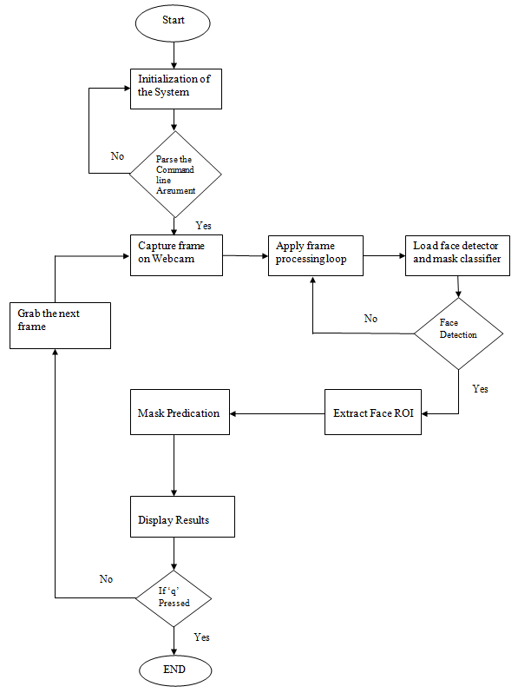
activity diagram

Slide 11
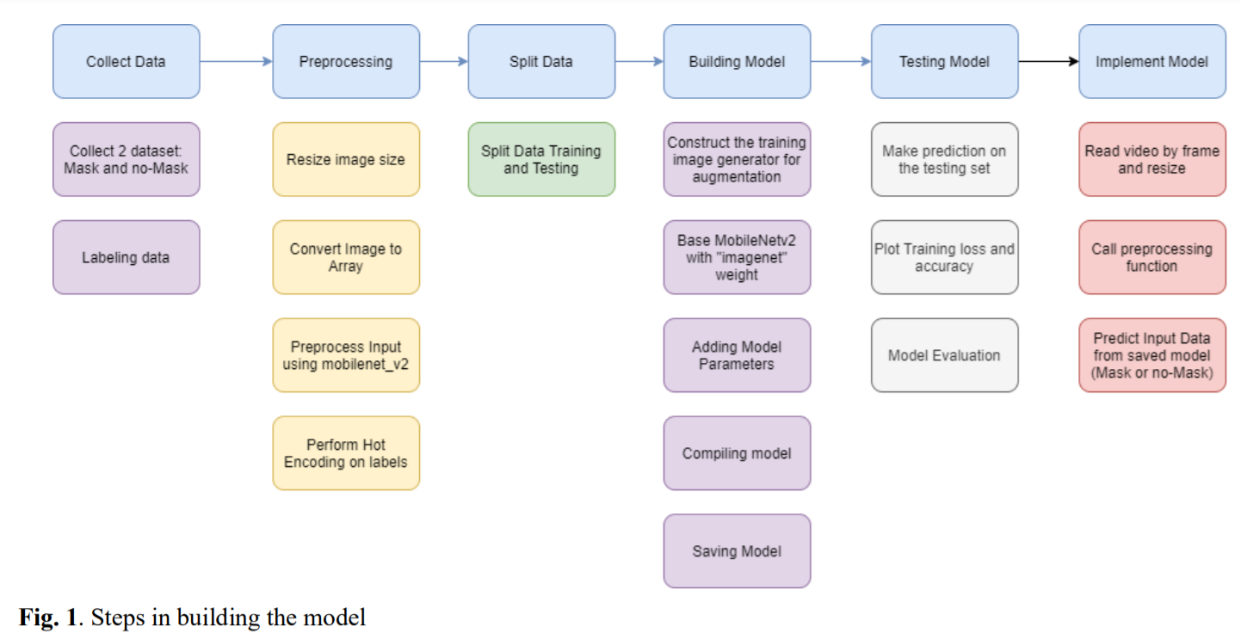
STEPS INVOLVED

Slide 12

PROGRAMING LANGUAGE USED:
Python (3.7.6)
LIBRARIES / MODULES USED:
OpenCV (Intel's Computer Vision Open Source Library) (4.2.0)
TensorFlow (1.14.0)
Keras (2.3.1) (TensorFlow backend)
sklearn (0.22.1)
imutils (0.5.3)
numpy (1.18.2)
matplotlib (3.1.3)
argparse (1.1)

Slide 13
EXPECTED OUTPUT:
A two-step system to first "detect" faces on an live video stream, using a trained face detector from OpenCV and after that to pass the found faces on the "mask predictor" that returns if the face is wearing a mask or not.
Using your webcam, the system developed applies face mask detection correctly to every frame in the real-time video stream.
Outputs the confidence probability of “Mask” or “No Mask” in the real-time video streams examined.

Slide 14
work done
There are two important steps in this project.
Face detection
Face mask detection
In face detection step the model has to initially detect the faces in the video stream using face detection techniques.
In face mask detection step the model takes the input from face detection step and process the input data and predicts whether a person wearing a mask or not with a specified precision.

Slide 15
FACE DETECTION
OpenCV (3.3 or later) comprises of the highly efficient dnn module supported by a number of deep learning frameworks such as Caffe, TensorFlow, and Torch/PyTorch.
This module has a more accurate, high performance Caffe-based face detector.
This face detector is based on single shot detector framework with a RESNET base network.
We also have OpenCV’s Haar cascades detectors but they are not suitable for angled position faces and in dim lights.

Slide 16
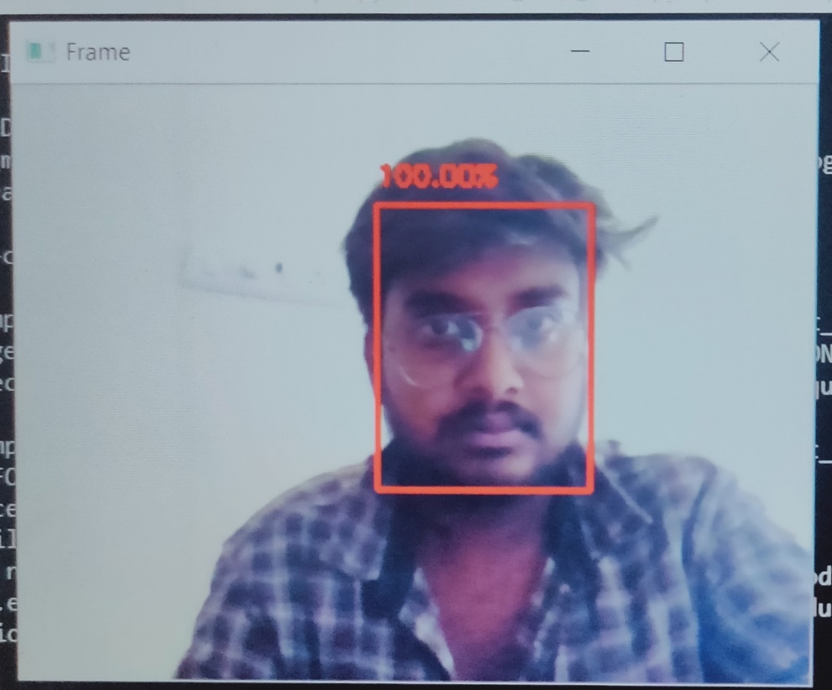
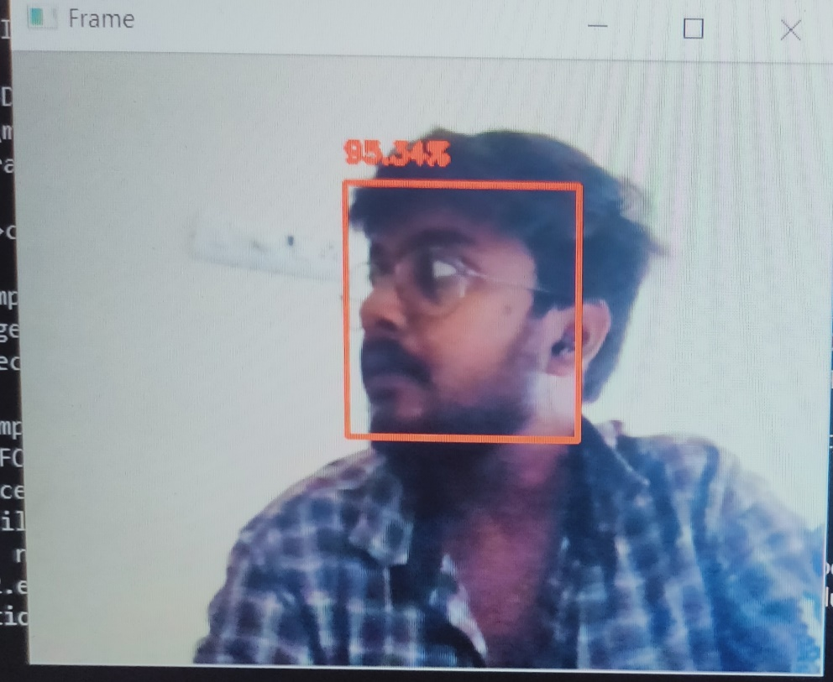
FACE DETECTION:
Face detection output results

Slide 17
Dataset pre-processing
We have two sets which are divided into with_mask and with_out_mask folders.
These folders consists of real faces wearing protective masks and not wearing masks.
No morphed faces with masks are used.
After collection of datasets we deleted some images which are being blurred and not fruitful and done with the data pruning.

Slide 18
This dataset consists of 4095 images belonging to two classes:
• with_mask: 2165 images
• without_mask: 1930 images
The dataset will be split into 80% training and 20% testing data with the help of sklearn library.
The training set has roughly 3276 images and the testing set has roughly 819 images.

Slide 19
Training with datasets
We are having algorithms like R-CNN, YOLO, SSD, etc.,
But here we are using single shot multibox detection for its speed and accuracy and it better suits our model.
Network architectures like RESNET, VGG are occupying large amount of space about 200mb-500mb.
So we are using MobileNetV2 architecture which is specially designed for memory constrained devices like mobiles.

Slide 20
We are combinely using both MobileNet architecture and SSD framework for faster and memory efficient performance.
Data augmentation of images are done by using keras image generator module for generalization.
Here we are using Convnets which is our classifier, these deep neural nets automatically learns features from images in hierarchical fashion.
Instead of using it as a model we are making it as a feature extractor by taking activation before the last fully connected layer of the network.
These activation acts as feature vector for our model(classifier).

Slide 21
It is based on transfer learning algorithm.
By using MobileNetV2 we are creating a base model and do finetuning with our model(classifier).
This MobileNetV2 is pretrained on ‘ImageNet dataset’ which consists of 1.4 million images and 100 classes.
This base as a knowledge will help our model to detect whether mask or no mask.

Slide 22
IMPLEMENT MODEL
As the model runs video camera will be activated and reads the video from frame to frame.
Then face detection algorithm works and detect the faces if they are present.
From detected frames containing faces, reprocessing will be carried out like resizing, image size, array conversion.
We use the module of OpenCV’s blobFromImage and blobFromImages to facilitate image pre-processing, this will do mean subtraction, scaling and channel swapping.

Slide 23
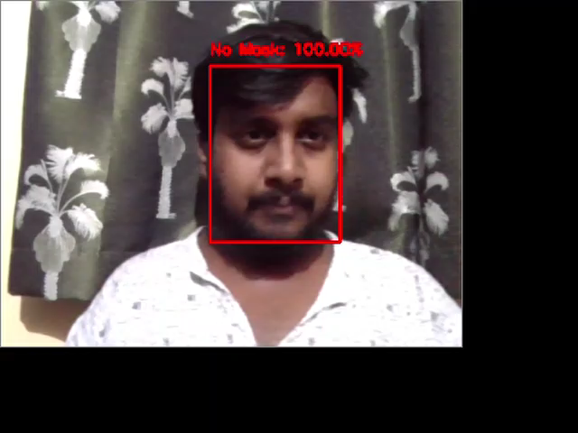
OUTPUT

Slide 24
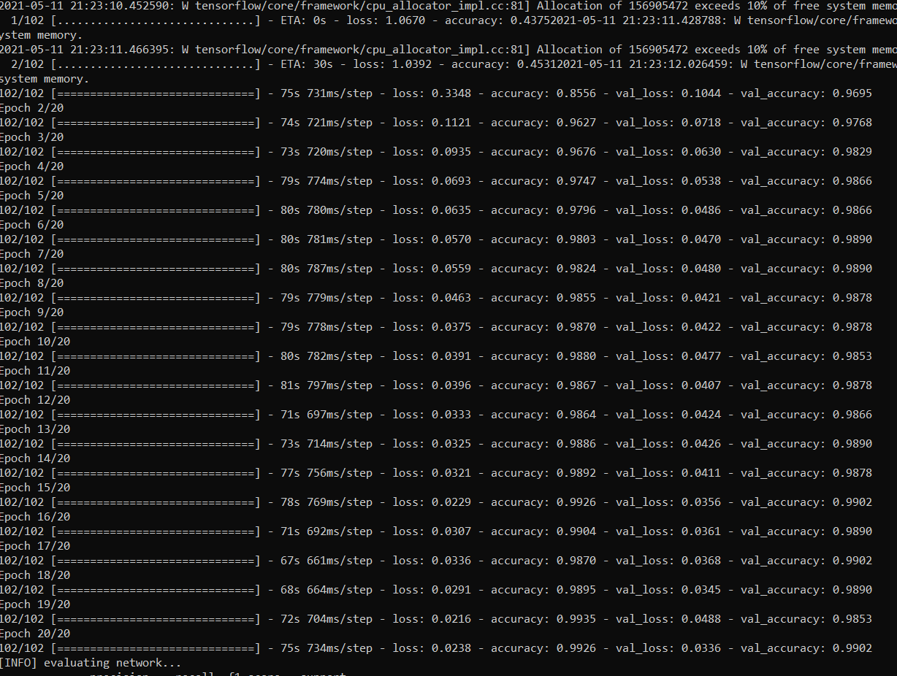
TESTING THE MODEL
Iteration of checking loss and accuracy

Slide 25
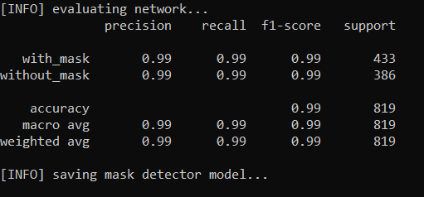
MODEL EVALUTION
From this we can say our model accuracy is 99%

Slide 26
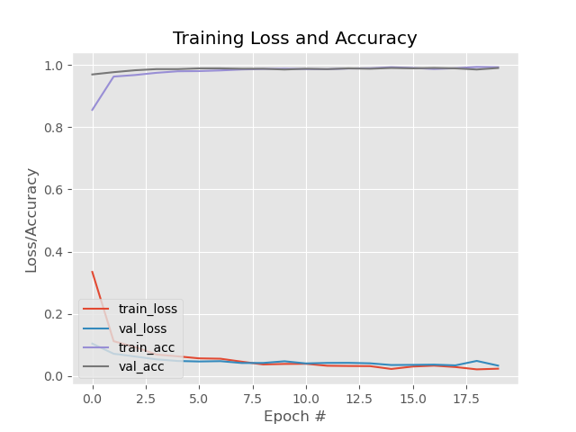
GRAPH OF TRAINING LOSS AND ACURACY

Slide 27
Advantages and applications
ADVANTAGES:
Automated Tracking System
Cost Effective
Easy to manage
APPLICATIONS:
Crowded areas
Hospitals
Traffic signals
Institutions

Slide 28
CONCLUSION
To create our face mask detector, we trained a two-class model with images of people wearing masks and not wearing masks.
We then fine-tuned our model using MobileNetV2 on our mask/no mask dataset and obtained an image classifier that was 99% accurate.

Slide 29
REFERENCES
Mohammad Rahman,Md.Milon,Jong-Hoon kim,”An Automated System to Limit COVID-19 using Facial Mask Detection in Smart City Network.”IEEE,April 2020
Samuel Ady Sanjaya,Suryo Adi ,”Face Mask Detection Using MobileNetv2 in the Era of COVID-19.”IEEE,2020
Marko Arsenovic, Andras Anderla ,” Deep learning based on face recognition system.” IEEE,2020
Facemask detection with Deep learning and Computer Vision,” Vinitha,Velanitine.”IEEE,2020
Covid-19 Face Mask Detection Using TensorFlow, Keras and OpenCV,” Mashhood Arijya Das,Rohini basak.”,IEEE,2020.

Slide 30


